Slide 1
CPR E 281: Digital Logic
Md Maruf Ahamed
Office: 307 Durham Center
Phone: (515) 294-6323
Email: maruf@iastate.edu

Slide 2
Administrative Stuff
  Homework: HW#7 due on Sunday @ 11:59 PM
  Quiz: Quiz #7 due on Friday @ 4:25 PM
  Recitation: Recitation 7 this week
  Lab: Lab 7 this week
  Lecture-23 Readings: 5.5, 5.6, 5.7

Slide 3
22-D Flip-Flops
  Gated SR Latch with NOR gates
  Gated SR Latch with NAND gates
  Gated D Latch
  Master-Slave D Flip-Flop
  Edge-Triggered D Flip-Flops
  Master-slave D flip-flop with Clear and Preset
  Edge-triggered D flip-flop with Clear and Preset
  Flip-Flop Timing Parameters

Slide 4
Chapter 5
Latches
Readings 5.1, 5.2, 5.3

Slide 5
A simple memory element with NOT Gates
x
x
x
A simple memory element with NAND Gates
x
x
x
A simple memory element with NOT Gates
x
x
x

Slide 6
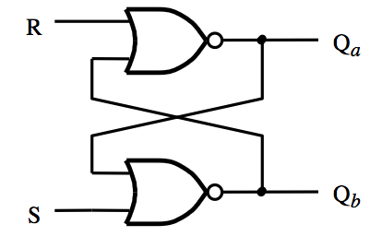
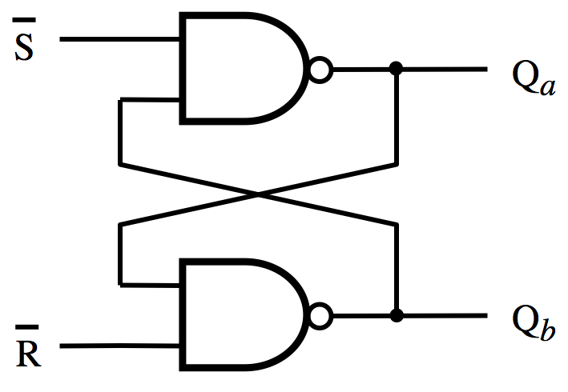
Basic Latch
(with NOR Gates)
Basic Latch
(with NAND Gates)
S
R
Q
a
Q
b
S
R
Q
a
Q
b
0
0
0/1 1/0
(no change)
Latch
0
0
0/1 1/0
(no change)
Latch
0
1
0
1
Reset
0
1
0
1
Reset
1
0
1
0
Set
1
0
1
0
Set
1
1
0
0
Undesirable
1
1
1
1
Undesirable
The two characteristic tables are the same
(except for the last row, which is the undesirable configuration).

Slide 7
Timing Diagram for the Basic Latch with NOR Gates
R
S
R
Q
a
Q
b
Q
a
0
0
0/1 1/0
(no change)
0
1
0
1
1
0
1
0
Q
1
1
0
0
S
b
(a) Circuit
(b) Characteristic table
A transition from
S=R=1 to
S=R=0
causes oscillations
of the two output
values Qa and Qb.
t
t
t
t
t
t
t
t
t
t
1
2
3
4
5
6
7
8
9
10
1
R
0
1
S
0
1
Q
a
?
0
1
Q
b
?
0
Time
(c) Timing diagram
[ Figure 5.4 from the textbook ]

Slide 8
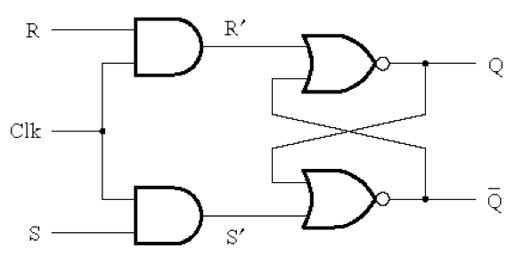
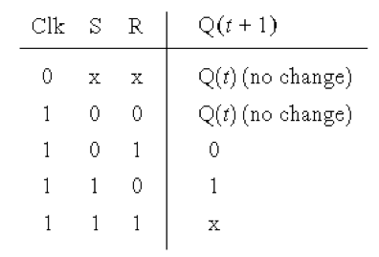
Gated SR latch with NOR gates
(undesirable)
Gated SR latch with NAND gates
S
Q
Clk
Q
(undesirable)
R
Characteristic tables are the same

Slide 9
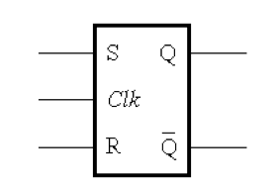
Gated SR latch with NOR gates
Gated SR latch with NAND gates
S
Q
Clk
Q
R
Graphical symbols are the same

Slide 10
Gated D Latch

Slide 11
Motivation
Dealing with two inputs (S and R) could be messy. For example, we may have to reset the latch before some operations in order to store a specific value but the reset may not be necessary depending on the current state of the latch.
Why not just have one input and call it D.
The D latch can be constructed using a simple modification of the SR latch.

Slide 12
Circuit Diagram for the Gated D Latch
S
Q
Clk
Q
R
[ Figure 5.7a from the textbook ]

Slide 13
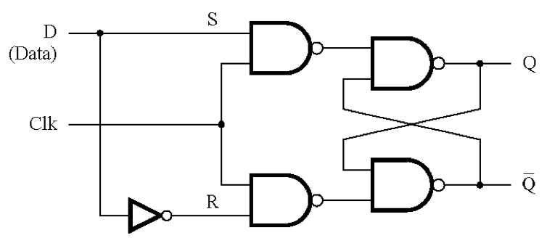
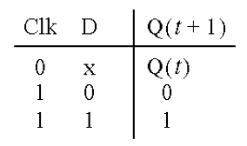
Circuit Diagram and Characteristic Table
for the Gated D Latch
This is the only
new thing here.
Note that it is now impossible to have S=R=1.
[ Figure 5.7a,b from the textbook ]

Slide 14
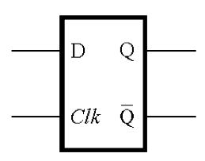
Circuit Diagram and Characteristic Table
for the Gated D Latch
When Clk=1 the output follows the D input.
When Clk=0 the output cannot be changed.
[ Figure 5.7a,b from the textbook ]

Slide 15
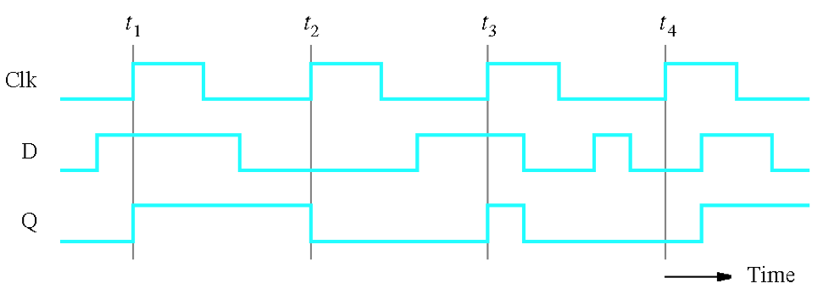
Timing Diagram for the Gated D Latch
[ Figure 5.7d from the textbook ]

Slide 16
Timing Diagram for the Gated D Latch
[ Figure 5.7d from the textbook ]

Slide 17
Timing Diagram for the Gated D Latch
[ Figure 5.7d from the textbook ]

Slide 18
Effects of Propagation Delay: Setup and hold times
t
su
t
h
Clk
D
Q
Setup time (t_{su}) – the minimum time that the D signal must be stable
prior to the negative edge of the Clock signal.
Hold time (t_{h}) – the minimum time that the D signal must remain stable
after the negative edge of the Clock signal.
[ Figure 5.8 from the textbook ]

Slide 19
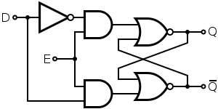
Circuit Diagram for the Gated D Latch
(with the latch implemented using NANDs vs NORs)
R
Clk
S
[ Figure 5.7a from the textbook ]
[https://en.wikibooks.org/wiki/Digital_Circuits/Latches]

Slide 20
Some Practical Examples

Slide 21
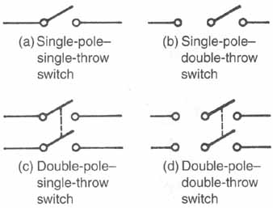
Different Types of Switches
http://www.industrial-electronics.com/Electricity-Refrigeration-Heating-Air-Conditioning_5b.html

Slide 22
Different Types of Switches
If you are building a circuit with latches
you’ll need to use this type of switch.
http://www.industrial-electronics.com/Electricity-Refrigeration-Heating-Air-Conditioning_5b.html

Slide 23
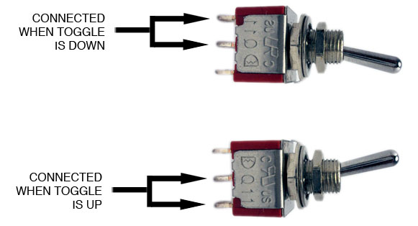
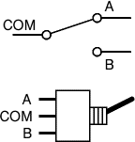
Single Pole, Double Throw = SPDT
[http://www.cubisteffects.com/images/MIY/Pt3_Throw.jpg]

Slide 24
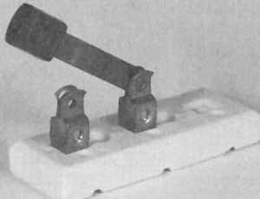
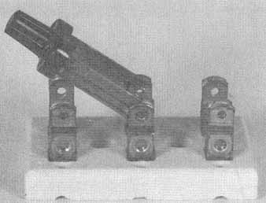
Single-pole—single-throw manual switch
Double-pole—double-throw manual switch
http://www.industrial-electronics.com/Electricity-Refrigeration-Heating-Air-Conditioning_5b.html

Slide 25

The following examples came from this book

Slide 26
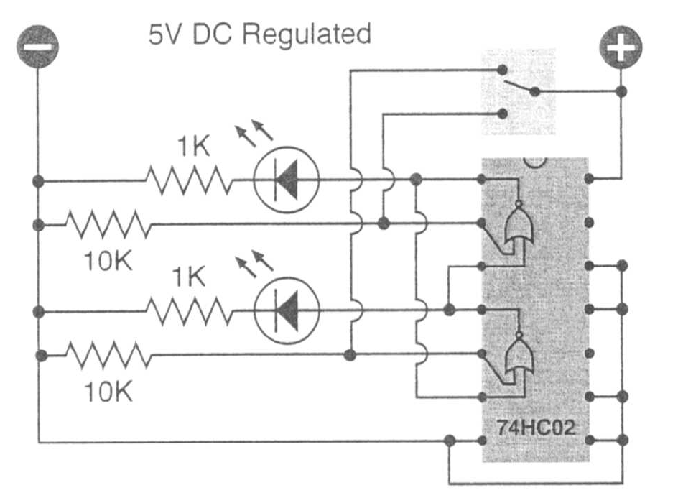
A Simple Circuit
[ Platt 2009 ]

Slide 27
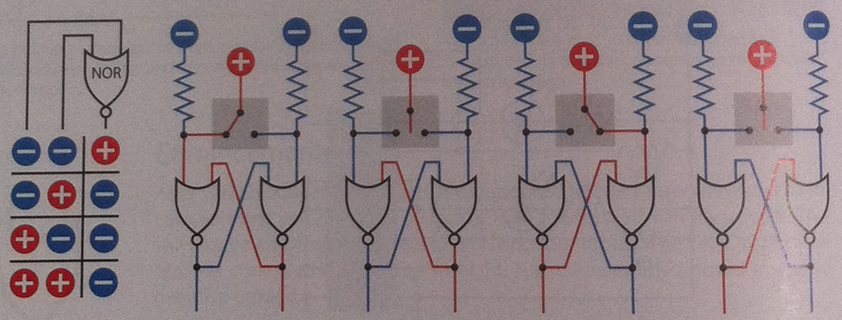
Let’s Take a Closer Look at This
[ Platt 2009 ]

Slide 28
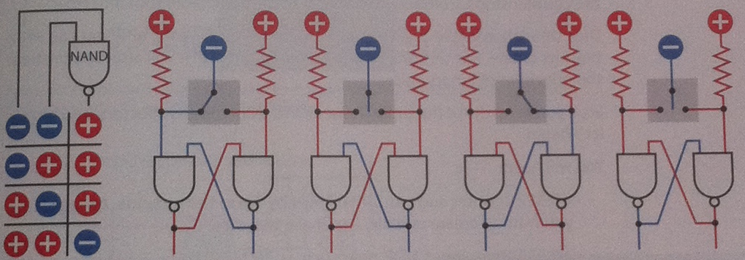
A Similar Example with NAND Gates
[ Platt 2009 ]

Slide 29
D Flip-Flops
Readings 5.4

Slide 30
Master-Slave D Flip-Flop

Slide 31
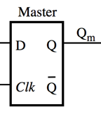
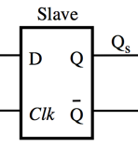
Constructing a Master-Slave D Flip-Flop
From Two D Latches

Slide 32
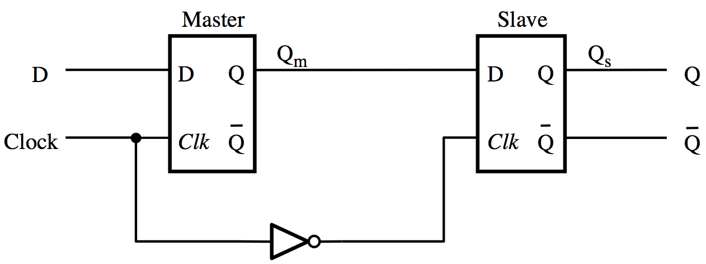
Constructing a Master-Slave D Flip-Flop
From Two D Latches
[ Figure 5.9a from the textbook ]

Slide 33
Constructing a Master-Slave D Flip-Flop
From Two D Latches
Master
Slave

Slide 34
Constructing a Master-Slave D Flip-Flop
From Two D Latches
Master
Slave

Slide 35
Constructing a Master-Slave D Flip-Flop
From Two D Latches
Master
Slave

Slide 36
Constructing a Master-Slave D Flip-Flop
From one D Latch and one Gated SR Latch
(This version uses one less NOT gate)
Master
Slave

Slide 37
Constructing a Master-Slave D Flip-Flop
From one D Latch and one Gated SR Latch
(This version uses one less NOT gate)
Master
Slave

Slide 38
Timing Diagram for the Master-Slave D Flip-Flop
Clock
D
Q
m
Q
=
Q
s
Master
Slave
Q
Q
D
D
Q
m
D
Q
s
Q
Clock
Clk
Q
Clk
Q
Q
[ Figure 5.9a,b from the textbook ]

Slide 39
Timing Diagram for the Master-Slave D Flip-Flop
t₁ t₂ t₃
Clock
D
Q
m
Q
=
Q
s
Master
Slave
Q
Q
D
D
Q
m
D
Q
s
Q
Clock
Clk
Q
Clk
Q
Q
[ Figure 5.9a,b from the textbook ]

Slide 40
Timing Diagram for the Master-Slave D Flip-Flop
t₁ t₂ t₃
Clock
D
Q
m
Q
=
Q
s
Master
Slave
Q
Q
D
D
Q
m
D
Q
s
Q
Clock
Clk
Q
Clk
Q
Q
[ Figure 5.9a,b from the textbook ]

Slide 41
Edge-Triggered D Flip-Flops

Slide 42
Motivation
In some cases we need to use a memory storage device that can change its state no more than once during each clock cycle.

Slide 43
Negative-Edge-Triggered Master-Slave D Flip-Flop
D
Q
Q
Positive-Edge-Triggered Master-Slave D Flip-Flop
D
Q
Q
The > means that this is edge-triggered
The small circle means that is is the negative edge

Slide 44
Negative-Edge-Triggered Master-Slave D Flip-Flop
Master
Slave
Q
Q
D
D
Q
m
D
Q
s
Q
Clock
Clk
Q
Clk
Q
Q
Positive-Edge-Triggered Master-Slave D Flip-Flop
Master
Slave
Q
Q
D
D
Q
m
D
Q
s
Q
Clock
Clk
Q
Clk
Q
Q

Slide 45
D Flip-Flop:
A Double Door Analogy

Slide 46
Positive-Edge-Triggered
Master-Slave D Flip-Flop
Master
Slave
Q
Q
D
D
Q
m
D
Q
s
Q
Clock
Clk
Q
Clk
Q
Q
Clock

Slide 47
Positive-Edge-Triggered
Master-Slave D Flip-Flop
Master
Slave
Q
Q
D
D
Q
m
D
Q
s
Q
Clock
Clk
Q
Clk
Q
Q
Clock

Slide 48
Positive-Edge-Triggered
Master-Slave D Flip-Flop
Master
Slave
Q
Q
D
D
Q
m
D
Q
s
Q
Clock
Clk
Q
Clk
Q
Q
Clock

Slide 49
Positive-Edge-Triggered
Master-Slave D Flip-Flop
Master
Slave
Q
Q
D
D
Q
m
D
Q
s
Q
Clock
Clk
Q
Clk
Q
Q
Clock

Slide 50
Negative-Edge-Triggered
Master-Slave D Flip-Flop
Master
Slave
Q
Q
D
D
Q
m
D
Q
s
Q
Clock
Clk
Q
Clk
Q
Q
Clock

Slide 51
Negative-Edge-Triggered
Master-Slave D Flip-Flop
Master
Slave
Q
Q
D
D
Q
m
D
Q
s
Q
Clock
Clk
Q
Clk
Q
Q
Clock

Slide 52
Negative-Edge-Triggered
Master-Slave D Flip-Flop
Master
Slave
Q
Q
D
D
Q
m
D
Q
s
Q
Clock
Clk
Q
Clk
Q
Q
Clock

Slide 53
Negative-Edge-Triggered
Master-Slave D Flip-Flop
Master
Slave
Q
Q
D
D
Q
m
D
Q
s
Q
Clock
Clk
Q
Clk
Q
Q
Clock

Slide 54
Other Types of Edge-Triggered
D Flip-Flops

Slide 55
Comparison of level-sensitive and edge-triggered D storage elements
D
D
Q
Q
Clock
a
Clock
Clk
Q
Q
a
D
D
Q
Q
b
Q
a
Q
Q
b
Q
b
D
Q
Q
c
Q
c
Q
Q
c

Slide 56
Comparison of level-sensitive and edge-triggered D storage elements
t₁ t₂ t₃ t₄
D
D
Q
Q
Clock
a
Clock
Clk
Q
Q
a
D
D
Q
Q
b
Q
a
Q
Q
b
Q
b
D
Q
Q
c
Q
c
Q
Q
c

Slide 57
Comparison of level-sensitive and edge-triggered D storage elements
t₁ t₂ t₃ t₄
D
D
Q
Q
Clock
a
Clock
Clk
Q
Q
a
D
D
Q
Q
b
Q
a
Q
Q
b
Q
b
D
Q
Q
c
Q
c
Q
Q
c

Slide 58
D
D
Q
Q
Comparison of level-sensitive and edge-triggered D storage elements
a
Clock
Clk
Q
Q
a
D
Q
Q
b
Q
Q
Level-sensitive
(the output mirrors the D input when Clk=1)
b
D
Q
Q
c
Q
Q
c
Clock
D
Q
a
Q
b
Q
c

Slide 59
D
D
Q
Q
Comparison of level-sensitive and edge-triggered D storage elements
a
Clock
Clk
Q
Q
a
D
Q
Q
b
Q
Q
Positive-edge-triggered
b
D
Q
Q
c
Q
Q
c
Clock
D
Q
a
Q
b
Q
c

Slide 60
D
D
Q
Q
Comparison of level-sensitive and edge-triggered D storage elements
a
Clock
Clk
Q
Q
a
D
Q
Q
b
Q
Q
Negative-edge-triggered
b
D
Q
Q
c
Q
Q
c
Clock
D
Q
a
Q
b
Q
c

Slide 61
A positive-edge-triggered D flip-flop
1
P3
2
P1
5
Q
Clock
P2
6
Q
3
D
Q
4
P4
Clock
Q
D
(a) Circuit
(b) Graphical symbol
[ Figure 5.11 from the textbook ]

Slide 62
A positive-edge-triggered D flip-flop
This circuit behaves like a positive-edge-triggered
D flip-flop, but it uses only 6 NAND gates.
Thus, it can be implemented with fewer transistors
than the master-slave D flip-flop.
1
P3
2
P1
5
Q
Clock
P2
6
Q
3
D
Q
4
P4
Clock
Q
D
(a) Circuit
(b) Graphical symbol
[ Figure 5.11 from the textbook ]

Slide 63
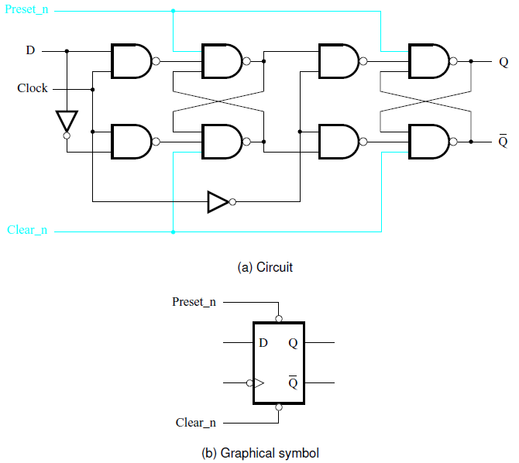
Master-slave D flip-flop with Clear and Preset
[ Figure 5.12 from the textbook ]

Slide 64
Positive-edge-triggered D flip-flop with Clear and Preset

Slide 65
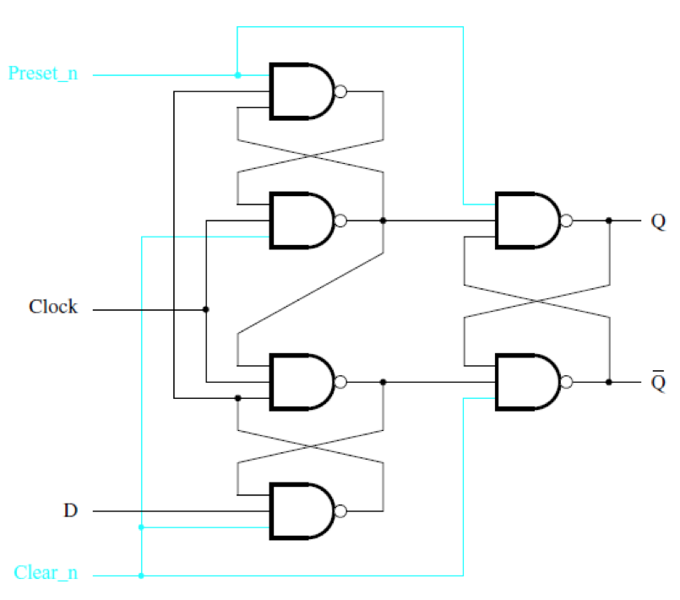
Positive-edge-triggered D flip-flop
with Clear and Preset
[ Figure 5.13a from the textbook ]

Slide 66
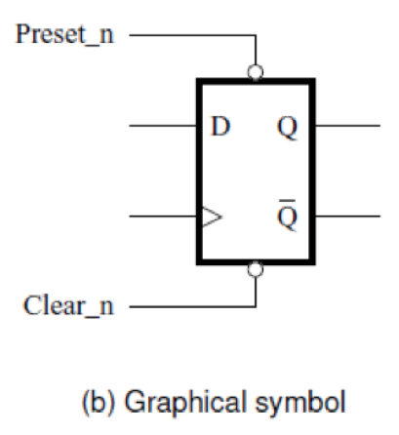
Positive-edge-triggered D flip-flop
with Clear and Preset
[ Figure 5.13b from the textbook ]

Slide 67
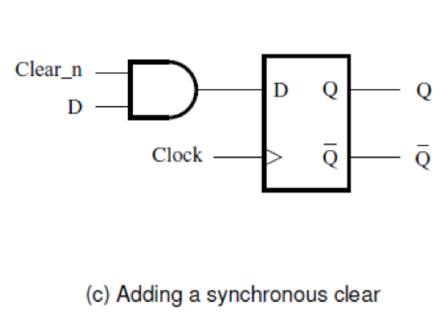
Positive-edge-triggered D flip-flop
with Synchronous Clear
The output Q can be cleared only on the positive clock edge.
[ Figure 5.13c from the textbook ]

Slide 68
Positive-edge-triggered D flip-flop
with Synchronous Clear
The output Q can be cleared only on the positive clock edge.
[ Figure 5.13c from the textbook ]

Slide 69
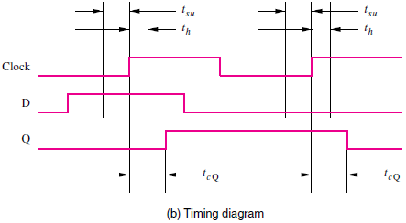
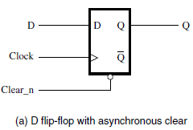
Flip-Flop Timing Parameters
[ Figure 5.14 from the textbook ]

Slide 70
Flip-Flop Timing Parameters
[ Figure 5.14 from the textbook ]

Slide 71
Flip-Flop Timing Parameters
[ Figure 5.14 from the textbook ]

Slide 72
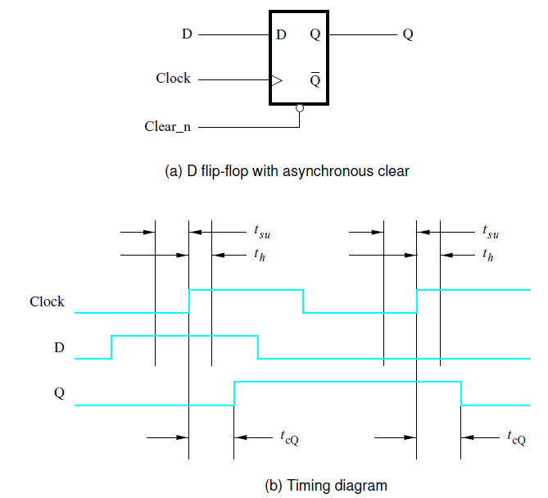
Flip-Flop Timing Parameters
Setup time
Hold time
clock-to-Q
propagation delay
[ Figure 5.14 from the textbook ]

Slide 73
Terminology
Basic Latch – is a feedback connection of two NOR gates or two NAND gates, which can store one bit of information. It can be set using the S input and reset to 0 using the R input.
Gated Latch – is a basic latch that includes input gating and a control input signal. The latch retains its existing state when the control input is equal to 0. Its state may be changed when the control signal is equal to 1.
[ Section 5.7 in the textbook ]

Slide 74
Terminology
Two types of gated latches
(the control input is the clock):
Gated SR Latch – uses the S and R inputs to set the latch to 1 or reset it to 0.
Gated D Latch – uses the D input to force the latch into a state that has the same logic value as the D input.
[ Section 5.7 in the textbook ]

Slide 75
Terminology
Flip-Flop – is a storage element that can have its output state changed only on the edge of the controlling clock signal.
Positive-edge triggered – if the state changes when the clock signal goes from 0 to 1.
Negative-edge triggered – if the state changes when the clock signal goes from 1 to 0.
[ Section 5.7 in the textbook ]

Slide 76
Terminology
The word latch is mainly used for storage elements, while clocked devices are described as flip-flops.
A latch is level-sensitive, whereas a flip-flop is edge-sensitive. That is, when a latch is enabled it becomes transparent, while a flip flop's output only changes on a single type (positive going or negative going) of clock edge.
[http://en.wikipedia.org/wiki/Flip-flop_(electronics)]

Slide 77

END Slide

